Slide 1
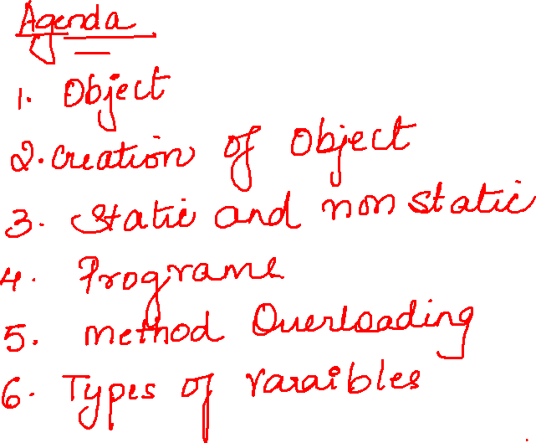

Slide 2
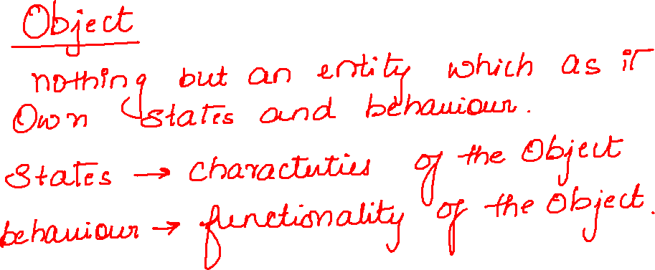

Slide 3
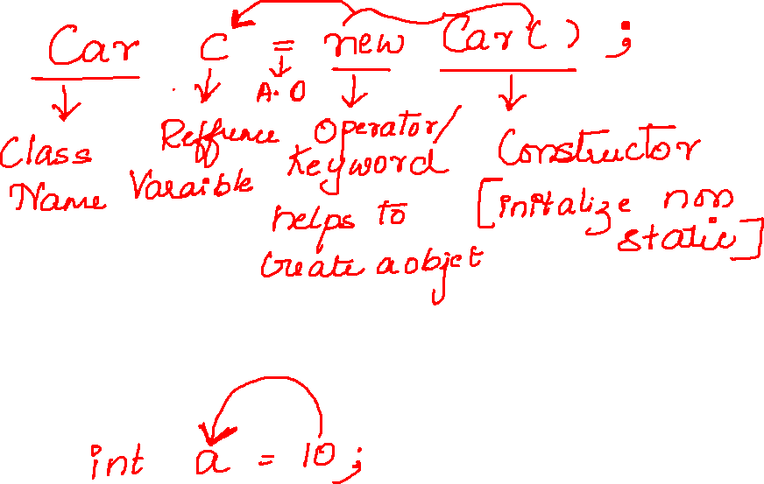

Slide 4
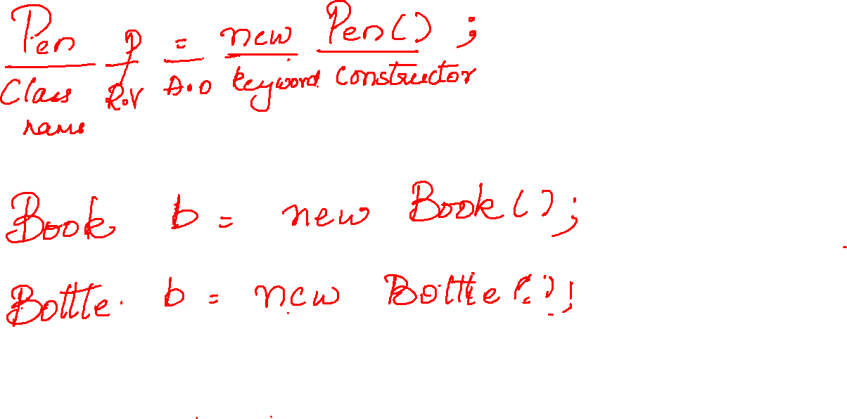

Slide 6
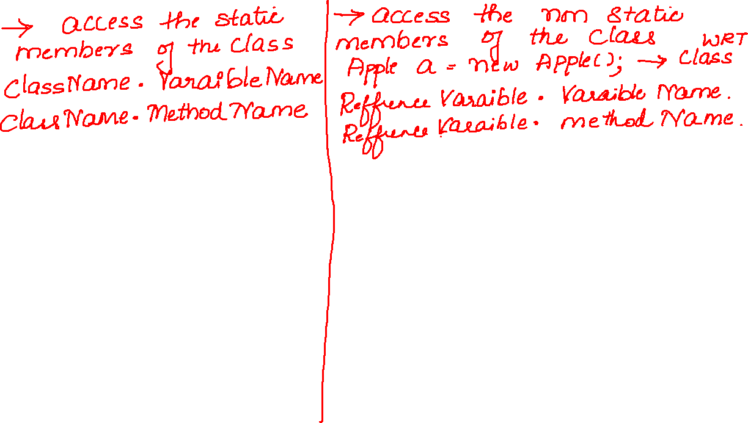



Slide 7


Slide 8
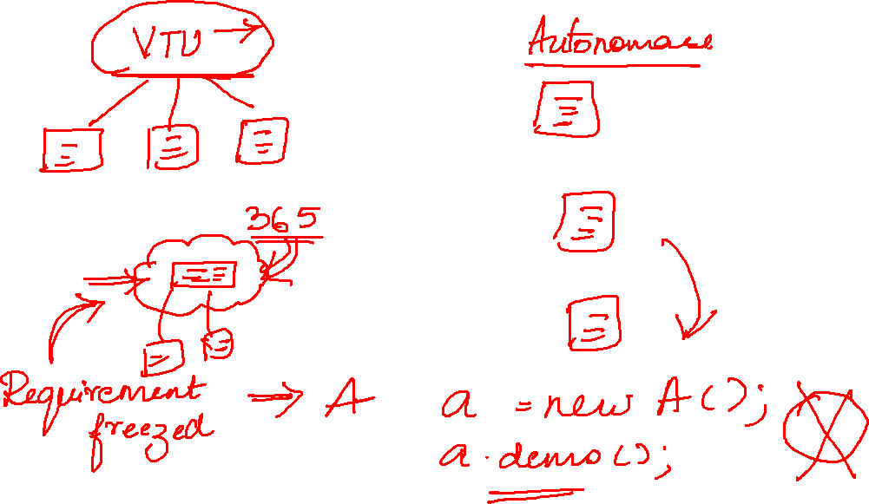

Slide 9
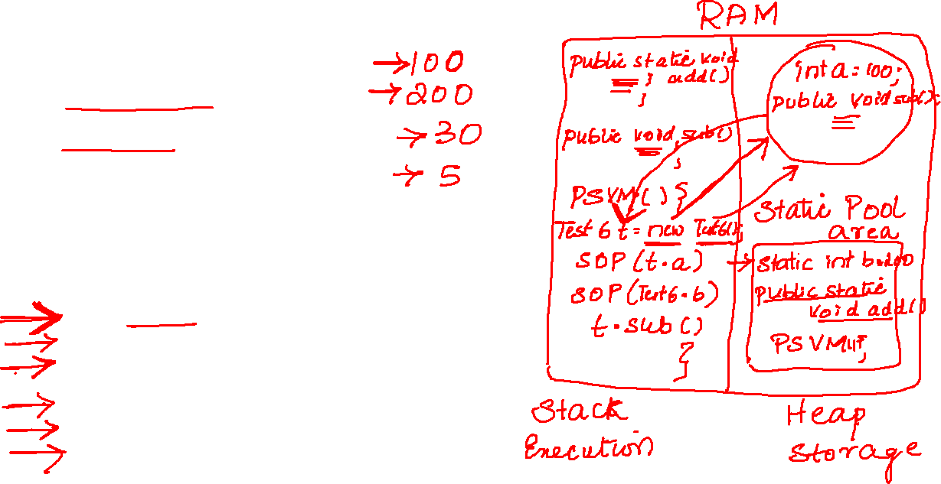
int a=100;
static int b=200;
public static void add() {
System.out.println(10+20);
}
public void sub() {
System.out.println(10-5);
}
public static void main(String[] args) {
Test6 t=new Test6();
System.out.println(t.a);
System.out.println(Test6.b);
Test6.add();
t.sub();

Slide 10


Slide 12
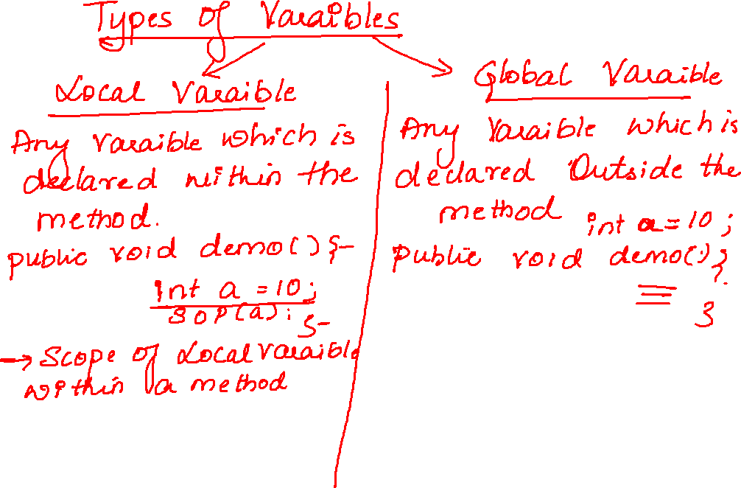


Slide 13
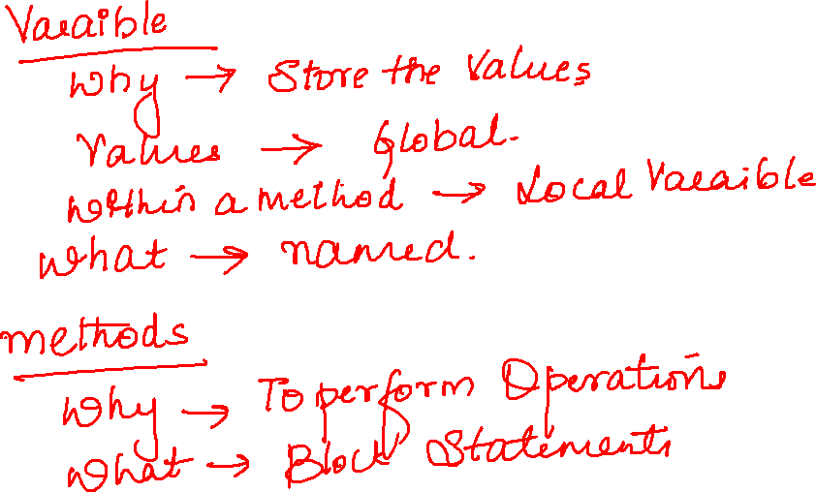

Slide 14
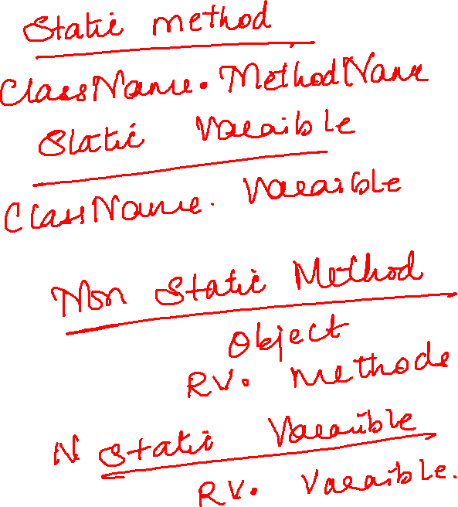

Slide 15
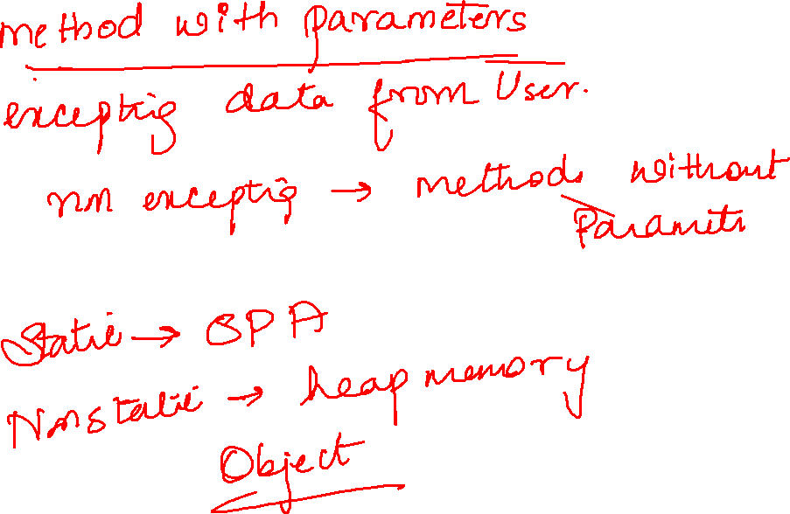

Slide 16
